Slide 1
PERMACULTURE
This program was introduced in Malawi through
Mothers Union by Love’s Harvest and ERD
(Episcopal Relief Development).
The program started in Southern Malawi Diocese
as a pilot project with one group of 20 women.
Later on after being successful, the other three
Dioceses were given grants and so far 18 groups of
20 women each have benefited from the grants in
all the Dioceses.
For each group, women and men are trained and
encouraged to have a demonstration garden and
their own gardens in their various homes.
No artificial or chemical fertilizer is used. Only
manure from the droppings of their animals /
livestock.

Slide 2
Perma-culture cont:

Slide 3
Perma-culture
Some of the Mother’s union members showing off the goats which they received from Mother’s Union.
Each of the twenty women received a she goat. When the goat bears a kid, it is given to another member of Mothers Union, who together with others form a new group. This is a pass on project.
In some areas, women received pigs instead of goats and the same pass on project is being implemented.
The droppings of their pigs and goats are also used as manure in their gardens.

Slide 4
St. Mark’s Parish Orphan Care project
Orphans at the above mentioned parish displaying their tinsmiths products. They sell their items in-order to source funds to buy their necessities.
These orphans are fed by the Mothers union at the parish.
Some orphans are at school and their tuition is paid by the Mother’s Union.

Slide 5
SAVINGS AND CREDIT (MICROFINANCE)
Though many women and a few men are able to read and write and numerate, and are accredited, few use their knowledge.
It was for this reason that Anne Figge of Five Talents in 2010 came to Malawi and conducted a training of trainers in Savings and Credit together with three facilitators; one from Southern Diocese and two from Diocese of Northern Malawi.

Slide 6
Microfinance cont:
After the training, a small amount of money was sent to all the four Diocese to train men and women in Savings and Credit.
Ten MULDP facilitators were trained in each Diocese.
Later on other MU Leaders, such as Archdeaconry leaders, Parish leaders, were also trained
So far the number of beneficiaries of this program is 1984 in all the Dioceses.
Now men and women who were accredited and trained in Savings and Credit, no longer stay idle.

Slide 7
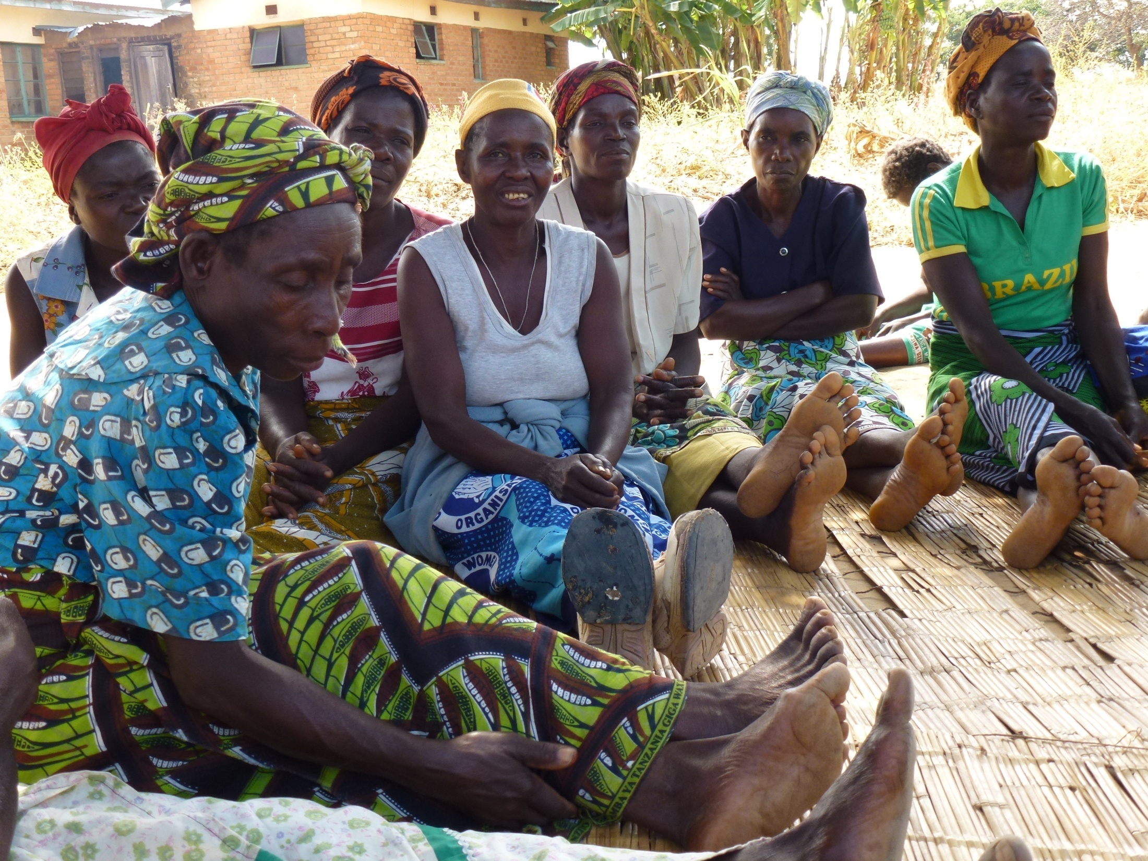
Notes:
Women discussing Savings and Credit at a meeting.

Slide 8
Savings and credit cont: (Record keeping)

